Slide 1
Pune Vidyarthi Griha’s College of Engineering & Technology &G. K. Pate (Wani) Institute of Management, Pune
DEPARTMENT OF ELECTRONICS AND TELECOMMUNICATION ENGINEERING
Academic Year: 2024-2025
Proposed Project Title: Automated Electricity Metering System
Name of Project Group members
1.Aniket Gund
2.Bhushan Ranade
3.Vaishnavi Borude
4.Rohan Khilari
Name of Guide: Dr. Y.B. Thakare
Company Assigned Guide: Mr. Kunal Pamu
Name of sponsored company: ABCD Analytics

Slide 2
Introduction:
Currently, MSEB employees manually visit each consumer's home to capture meter readings, but unclear images often lead to billing errors and unexpected billing charges. This manual process also results in power disconnections when bills are unpaid, which is challenging. Additionally, the existing postpaid billing system does not provide real-time data, leading to inefficiencies and customer dissatisfaction.

Slide 3
Aim: To design and develop a Automated metering system with prepaid billing and remote control.
Objectives of the project:
Design and Deploy Smart Meters with Prepaid Billing: Install smart electricity meters compliant with relevant standards across residential sites, ensuring they support prepaid billing and include remote disconnection/reconnection functionalities to enhance user control over energy consumption.
Establish Advanced Communication System: Implement GPRS communication systems for real-time data transmission, meter status updates, and remote-control functionalities, providing seamless interaction between the smart meters and the user interface for both utility providers and consumers.
Integrate Automated Meter Reading (AMR) and Tamper Detection: Deploy AMR technology for accurate, real-time data collection and automated billing, while incorporating advanced tamper detection mechanisms to identify, log, and alert on tampering events to prevent unauthorized usage.

Slide 4
Outcomes:
Enhanced Billing Accuracy and Efficiency: Utilize advanced prepaid meters to ensure accurate and timely billing, reducing errors and providing mobile payment options for greater convenience and reliability.
Optimized Energy Management and Billing: Achieve precise meter readings and accurate billing, leading to effective load management and enhanced overall consumer satisfaction.
Real-Time Data Insights: Provide consumers and utility providers with real-time access to energy consumption data, allowing for improved monitoring, prompt issue resolution, and informed decision-making.
Effective Tamper Detection: Implement advanced tamper detection mechanisms that reduce unauthorized usage and ensure reliable billing, enhancing overall system integrity and security

Slide 5
Problem Definition:
To design Automated electricity metering system for single phase using ESP WROOM 32 controller, GPRS module and PZEM-004T energy metering module to provide consumption, prepaid billing , remote disconnection/reconnection and real time energy data monitoring .
Motivation:
The increasing demand for efficient energy management and billing systems in residential and industrial setups has led to the need for smart metering solutions. This project aims to simplify billing and consumption monitoring for both users and utility providers, offering transparency and automation through IoT technology.
Social Relevance of the project:
Implementing an Automated Metering System will significantly enhance the accuracy of billing and reduce customer dissatisfaction, promoting fair and transparent energy use. By minimizing the need for physical disconnections, this technology will contribute to a more reliable and user-friendly energy management system, benefiting both consumers and utility providers.

Slide 6
Literature Survey:
Title of Paper And Year | Technology/Algorithm used | Remarks
A Unified Metering System Deployed for Water and Energy Monitoring in Smart City (2023) | LPWAN, Water flow sensor, PZEM-004T | Integrated wireless system for real-time water and energy monitoring.
Utilization of IoT and Smart Meters for Energy Management (2023) | IoT, Entrack software | Effective energy management using IoT and smart meters.
Home Energy Management System in Kerala by Using Advanced Metering Infrastructure (2024) | IoT, Modbus communication, GSM modules | Real-time energy monitoring and management using advanced meters.
Design, Implementation, and Deployment of an IoT Based Smart Energy Management System (2021) | IoT, SEMS, non-intrusive load monitoring | IoT-based energy management with remote control and efficient data gathering.
Development of Indigenous Smart Energy Meter adhering Indian Standards for Smart Grid (2020) | AMI, Smart Grid, Demand Side Management | Smart meters with advanced features for Indian Smart Grid standards.

Slide 7
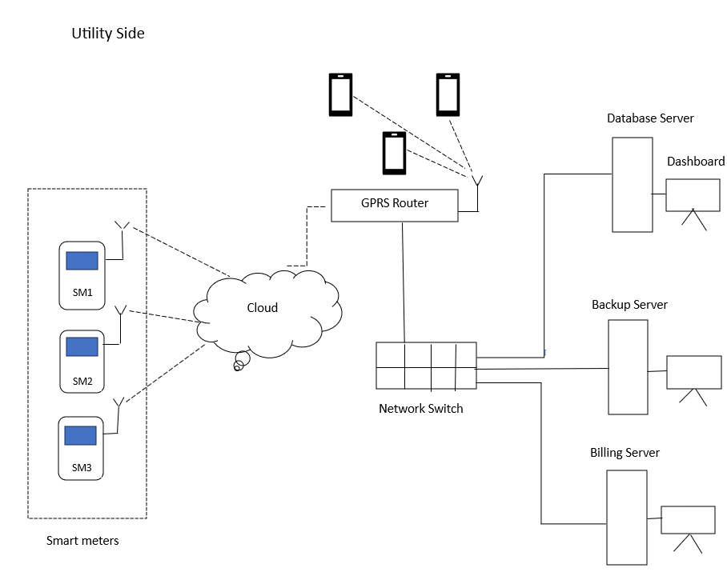
Proposed Block Diagram

Slide 8
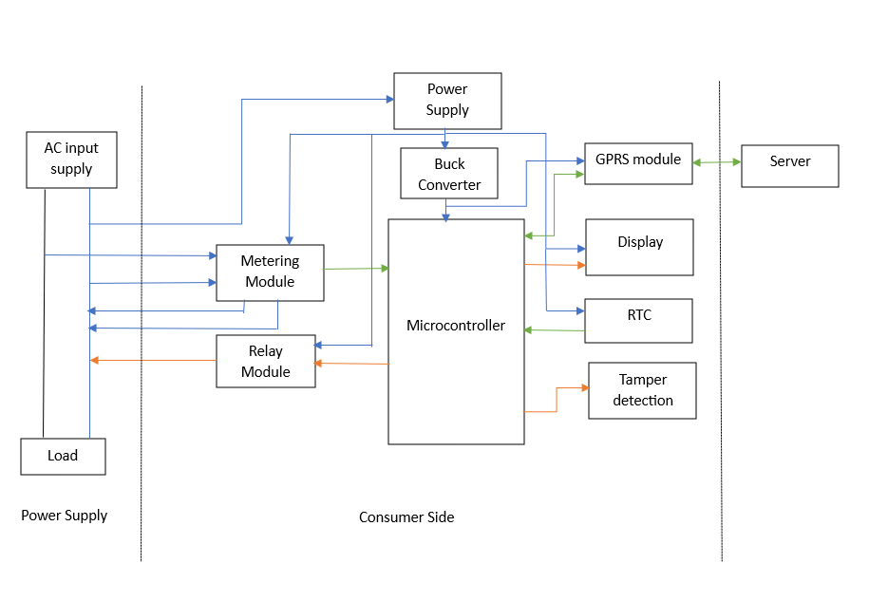

Slide 9
Selected Components:
Module Name | Module Number | Link
METERING MODULE | PZEM-004T | Link
MICRO-CONTROLLER | ESP 32 WROOM 32 | Link
RTC MODULE | DS3231 | Link
EEPROM MODULE | AT24C256 | Link
20*4 LCD | JHD629-204A | Link
GPRS | SIM 800L | Link
VOLTAGE SENSOR MODULE | ZMPT101B | Link
HALL EFFECT SENSOR MODULE | A1220 | Link
I2C MULTIPLEXER | TCA9548A | Link
PUSH BUTTON | PBS1 | Link
RELAY MODULE | SK90-S-DC5V-1C | Link
AC to DC SMPS Module | HLK-20M05 | Link

Slide 10
Features:
Prepaid Billing System
Low Funds Notification
Auto Electricity Disconnection
Time-of-Day (TOD) Notification
Slotted Hours Consumption Data
Power Information Display
Tamper Alert System

Slide 11
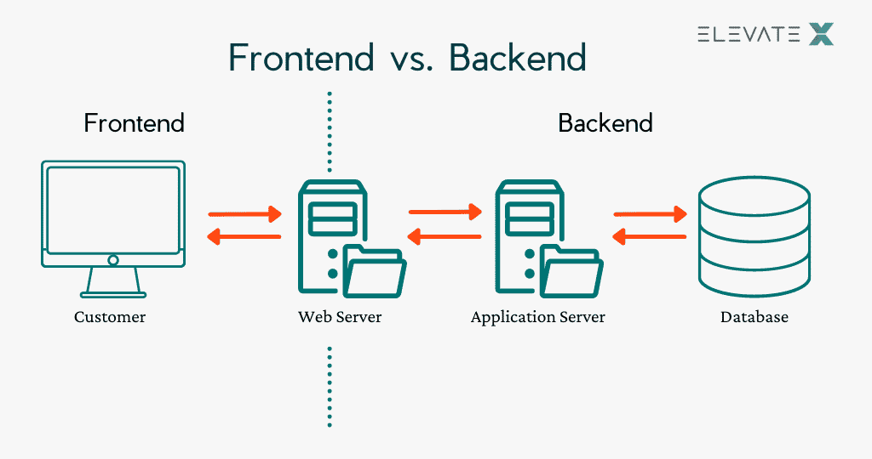
Software Design :
Front End :(HTML, CSS, JS, ReactJS)
User dashboard .
Admin dashboard .
Alert and notifications .
Backend :(JS, NodeJS)
API service.
Authentication and Authorization.
Database:(SQL)
Data Storage .
Data management.

Slide 12
References & Bibiliography
[1] N. Sushma, H. N. Suresh, J. Mohana Lakshmi, P. Naga Srinivasu, A. Kumar Bhoi, and P. Barsocchi, "A Unified Metering System Deployed for Water and Energy Monitoring in Smart City," *IEEE Access*, vol. XX, pp. 1-12, July 2023. DOI: 10.1109/ACCESS.2023.3299825.
[2] S. V. Sreedevi, P. Prasannan, J. K, and I. L. J I, "Development of Indigenous Smart Energy Meter adhering to Indian Standards for Smart Grid," in *2020 IEEE International Conference on Power Electronics, Smart Grid and Renewable Energy (PESGRE2020)*, Thiruvananthapuram, India, 2020.
[3] A. Babu, H. KJ, N. S, V. S. Pillai, R. K.P., and S. Sreekumar, "Home energy management system in Kerala by using advanced metering infrastructure," in *2024 Second International Conference on Smart Technologies for Power and Renewable Energy (SPECon)*, 2024. DOI: 10.1109/SPECon61254.2024.10537578.
[4] M. U. Saleem, M. R. Usman, and M. Shakir, "Design, Implementation, and Deployment of an IoT Based Smart Energy Management System," *IEEE Access*, vol. XX, pp. 1-12, April 2021. DOI: 10.1109/ACCESS.2021.3070960.
[5] S. Kumar, K. Suneetha, and A. Gill, "Utilization of IoT and Smart Meters for Energy Management," in *2023 International Conference on Power Energy, Environment & Intelligent Control (PEEIC)*, 2023.

Slide 13
[6] M. J. Jeffin, M. G. M., A. Rao, G. Singh, and C. Vyjayanthi, "Internet of Things Enabled Power Theft Detection and Smart Meter Monitoring System," in *International Conference on Communication and Signal Processing*, India, July 2020.
[7] H. A. Hseiki, A. M. El-Hajj, Y. O. Ajra, F. A. Hija, and A. M. Haidar, "A Secure and Resilient Smart Energy Meter," *IEEE Access*, vol. XX, pp. 1-12, Jan. 2024. DOI: 10.1109/ACCESS.2023.3349091.
[8] P. Kumari, R. Mishra, H. P. Gupta, T. Dutta, and S. K. Das, "An Energy Efficient Smart Metering System Using Edge Computing in LoRa Network," *IEEE Transactions on Sustainable Computing*, vol. 7, no. 4, pp. 1-12, Oct.-Dec. 2022.
[9] M. U. Saleem, M. R. Usman, M. A. Usman, and C. Politis, "Design, Deployment and Performance Evaluation of an IoT Based Smart Energy Management System for Demand Side Management in Smart Grid," *IEEE Access*, vol. XX, pp. 1-12, Jan. 2022. DOI: 10.1109/ACCESS.2022.3147484.
[10] F. Liu, C. Liang, and Q. He, "Remote Malfunctional Smart Meter Detection in Edge Computing Environment," *IEEE Access*, vol. XX, pp. 1-12, April 2020. DOI: 10.1109/ACCESS.2020.2985725.
[11] M. H. Raza, Y. M. Rind, I. Javed, M. Zubair, M. Q. Mehmood, and Y. Massoud, "Smart Meters for Smart Energy: A Review of Business Intelligence Applications," *IEEE Access*, vol. XX, pp. 1-12, Nov. 2023. DOI: 10.1109/ACCESS.2023.3326724.

Slide 14
[12] E. Sacoto-Cabrera, J. Rodriguez-Bustamante, P. Gallegos-Segovia, G. Arevalo-Quishpi, and G. León-Paredes, "Internet of Things: Informatic System for Metering with Communications MQTT over GPRS for Smart Meters," in *2017 IEEE International Conference on IoT and Smart Cities*, Cuenca, Ecuador.
[13] H. Tan, H. Yao, Y. Huang, H. Wang, Z. Zhao, and Y. Liu, "Error Correction Method for Smart Energy Meter Field Calibration System under Non-standard Conditions," in *2020 IEEE International Conference on Smart Energy Systems and Technologies*, Beijing, China.
[14] S. S. Chowdary, M. A. Abd El Ghany, and K. Hofmann, "IoT based Wireless Energy Efficient Smart Metering System Using ZigBee in Smart Cities," in *2020 International Conference on IoT, Smart Cities, and Smart Technologies*, Darmstadt, Germany and Cairo, Egypt.
[15] S. Katre and P. Ikhar, "Automatic MSEB Meter Reading," *International Research Journal of Engineering and Technology (IRJET)*, vol. 06, no. 05, pp. 371, May 2019.
[16] S. Sharma, H. Choudhary, H. Badetiya, L. Kumar, H. K. Aloria, and M. Jangid, "Smart Prepaid Energy Meter," *International Journal of Engineering Research & Technology (IJERT)*, vol. 12, no. 04, April 2023.
[17] M. Mali, V. Jeswani, V. Charya, D. Kamble, and S. Padasalkar, "The Smart Energy Meter," *International Journal for Research in Applied Science & Engineering Technology (IJRASET)*, vol. 9, no. II, Feb. 2021.

